Slide 1
CBCS-IDS
2022-23
Development of Curriculum for Programmes of
Inter-Disciplinary Studies
Dr. Vaishali P. Gudadhe (Choukhande)
Dean, Interdisciplinary Studies,
Professor & Head,
P. G. Teaching Department,
Library & Information Science,
Sant Gadge Baba Amravati University, Amravati

Slide 2
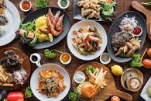
Credit Based Semester System
Choice Based Credit System
Notes:
Our present system is Credit based Semester system, provides flexibility in designing curriculum and assigning credits based on the course content and hours of teaching
The Choice Based Credit System provides a “Cafeteria “type of approach in which students can take courses of their choice, learn at their own pace, will undergo additional courses and acquire more than the required credits and adopt interdisciplinary approach to learning.
It is desirable to adopt CBCS and implement the grading system.
The basic motive is to expand academic quality in all aspects, right from the curriculum to the learning-teaching process to examination and evaluation systems.
Considering this diversity, there should be uniformity to implement CBCS as good system .
It will help to assess overall performance of a student in a universal way of a single grading system.

Slide 3
Interdisciplinary Studies -UG & PG Programmes
SN | BOS/Adhoc Committees -10 | Programmes (25)
1 | Performing Arts (Ad-hoc) | BPA MPA – Drama/Theatre, Dance (Kathak)
2 | Education (BOS) | B.Ed. M.Ed.
3 | Physical Education (BOS) | B.P.Ed. M.P.Ed. B.P.E.S.
4 | Home Science (BOS) 1) M.Sc (Food Science and Nutrition) 2) M.Sc (Human Development) M.Sc (Textile and Clothing) M.Sc (Extension and Communication) M.Sc (Resource Management) | B.Sc. Home Science M.Sc. Home Science (with five subjects of specialisation) Bachelor of Fashion Designing
5 | B.Sc. Animation (Ad-hoc) | 1) BSc. Animation
6 | Social Work (BOS) | BSW/B.A in Social work MSW/B.A in Social work
7 | Yogashashtra (Ad-hoc) | B.A. Yogashastra M. A. Yogashastra
8 | Journalism & Mass Communication (Ad-hoc) | B.A. (J.M.C.) M.A. (J.M.C.)
9 | Gender and Women Studies (Ad-hoc) | M.A. Gender and Women Studies
10 | Library & Information Science | 1) BLISC 2) MLISC
Notes:
Under Interdisciplinary studies, 10 Regular and Adhoc Boards, mostly are Adhoc Boards and 25 programmes.
As Education and Physical Education programme comes under NCTE and Library and Information science is only one year programme , going for revision of curriculum.

Slide 4
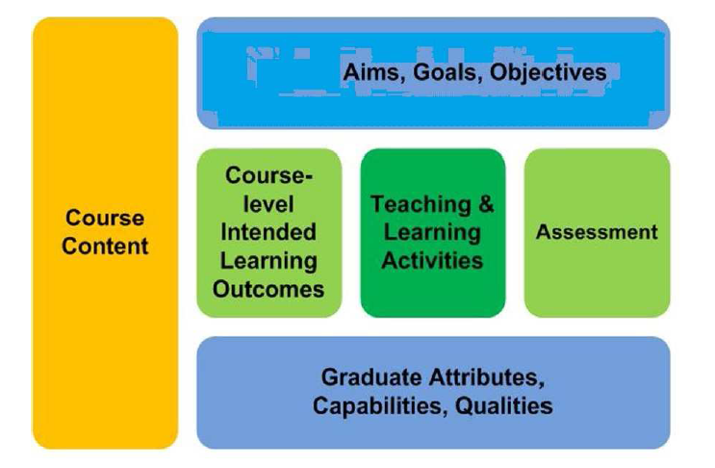
Notes:
When we discuss about Course content goals and objectives, course goals reflect the purpose of the course and may derived from a program of study.
Learning outcomes describes
What learners should know
Be able to do
And value as a result to integrating knowledge skills
Learns attitudes throughout the course, Learning outcomes are stated in measurable terms.
Learning Objectives describes intended result of a learning experience. These objectives are stated in measurable terms. It identify discrete aspects of learning outcomes or goal
We can say collectively they roll up to meet learning outcomes or goals.

Slide 5
Curriculum development
What sort of Library professionals/social workers/Animated film makers/ Art performers/ Nutritionist/Journalist/ Sportsman/teachers etc. do we want?
How will we reflect demands from external agencies?
What outcomes and content should we include?
What teaching and learning methods should we use?
How will we assess learners?
How should we establish links to evaluation?
Notes:
This is the process of Curriculum development
Questions should arise in our minds while designing and developing course content.

Slide 7
Learning outcomes should:
Be written in the future tense
Identify important learning requirements
Use language which students can understand
Be achievable
Be assessable

Slide 8
Learning outcomes
Acceptable verbs:
To describe
To compare
To analyse
To plan
To critically appraise
Unacceptable verbs:
To know
To understand
To appreciate
To enjoy
To believe
Notes:
Learning outcomes are very much important to share expectations between students and instructors.
These outcomes help students to learn more effectively
Also provides us clear direction when teaching and taking assessment decisions

Slide 9
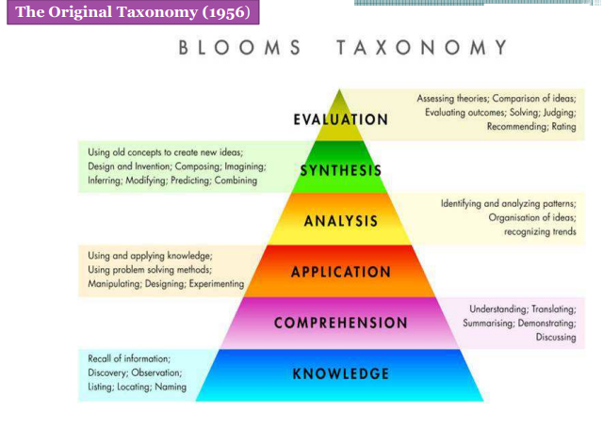
Notes:
We can follow Blooms Taxanomy which provides us levels in classified manner.
Bloom gives us hierarchical models which can be used to classify educational learning objectives.
First it was published in 1956 and revised in 2001

Slide 10
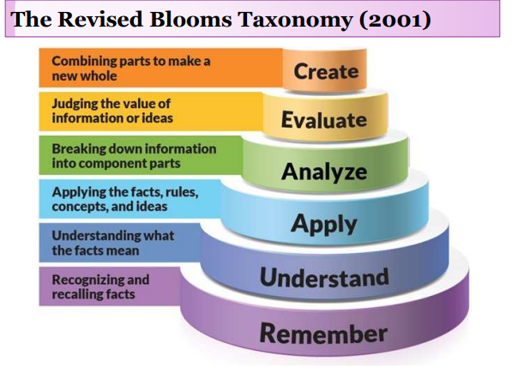
Notes:
Six levels Remember, Understand. Apply, Analyse, Evaluate and create.
Create in itself is creativity and innovation.

Slide 11
SOCIAL WORK- IDS
Program Objectives:
The Social Work Program provides students with the knowledge, values, and skills necessary for culturally sensitive generalist social work practice. The BSW curriculum is designed to prepare students to provide services that advances the well-being of people; promote social and economic justice; and enhance the social functioning of individuals, families, groups, organizations, and communities. It is our desire to provide students with both academic and field based experiences that allow the student to integrate theoretical and applied knowledge in order to engage in the planned change process at the micro, mezzo, and macro levels of practice.
Student Learning Outcomes:
Student Learning outcomes ,Specifically, the bachelor of social work program seeks to:
Demonstrate Ethical and Professional Behavior
Engage Diversity and Difference in Practice
Advance Human Rights and Social, Economic, and Environmental Justice
Engage In Practice-informed Research and Research-informed Practice
Engage in Policy Practice
Engage with Individuals, Families, Groups, Organizations, and Communities
Assess Individuals, Families, Groups, Organizations, and Communities
Intervene with Individuals, Families, Groups, Organizations, and Communities
Evaluate Practice with Individuals, Families, Groups, Organizations, and Communities
Notes:
Example of the programme Social work
How should be the Programme objectives and student learning outcomes

Slide 12
BSC ANIMATION- Course Outcomes
Graphics Art ,Students will able to:
• Have a proficiency in a broad range of design skills pertaining to publication design
• Have a basic understanding of typography, color, layout, tables, images, graphics, styles and interactive elements.
• Be able to navigate Adobe Workspace, Set up a document, and work with pages.
• Understand how to work with frames, importing & linking graphics
• Be able to import and edit text, work with typography and style sheets
• Efficiently use color, transparencies, and tables
• Have an understanding of output, exporting and packaging.
• Be able to create a print-ready document.
• Have the ability to create a well-designed layout, brochure or other design materials for print or web.
Production Process- Students will able to:
• Video Post-production is a linear process of film making.
• Video Post-production include Picture editing, Sound effects editing, Music composition, Visual effects, Sound mixing and Color correction.
• There are three processes of film making: Video Pre-production, Video Production and Video Post-production.
• Video Post-production is the last stage of film making process.
• Video Post-production process is started when shooting ends.
• Video Post-production Process follows the Video production phases.
Notes:
This programme is fully skill oriented
Students creates Videos in three phases
Video pre production, Video production and Video post production, lot of editing and effects in film making process

Slide 13
Format and Templates for Courses (Theory/Practical) of UG/PG Programmes
Preparation of Curriculum
Preparation of
PO- Program Objectives
PSOs- Program Specific Outcomes
CO-Course Outcomes/Internal Assessment
Preparation of Skill Components (UG Level)
Discipline Core Courses
Discipline Elective Courses
Notes:
You are provided with the format and templates for Theory and practical, in word file. Please insert your content into the template so that there will be uniformity.

Slide 14
Useful Resources
ugc.ac.in
Naac.gov.in
inflibnet.ac.in
E-pg-Pathshala
oer.org
Blooms Taxonomy :: Resource for Educators
https://bloomstaxonomy.net
Notes:
So we have to focus on preparation of curriculum today
Dr. Dudul sir has taken lot of efforts to prepare the templates under the guidance of Honourable VC Prof. Malkhede sir.
Please follow the instructions and provided check list including the useful resources .
You can refer to the links of useful resources.

Slide 15
THANKS FOR GIVING
AN OPPORTUNITY
Notes:
We all will accept , Its a team work .
We have to work hand in hands to achieve mission CBCS from the year 2022-23

